Slide 2
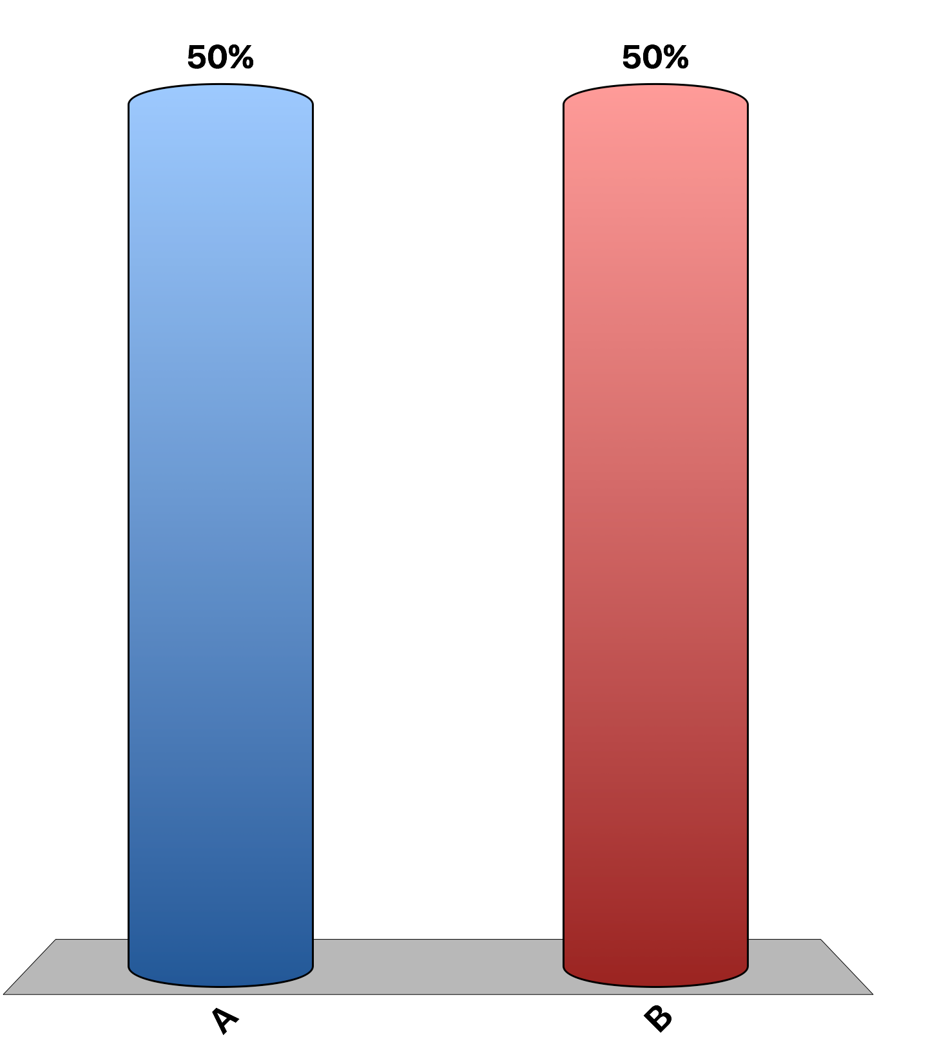
Taxes create market inefficiencies that can be measured as deadweight loss.
True
False

Slide 3
As the size of a tax increases, the size of the deadweight loss first increases, then decreases.
True
False

Slide 4
A policymaker that wants to raise tax revenue while minimizing the deadweight loss should tax goods with inelastic supply and demand rather than goods with elastic supply and demand.
True
False

Slide 5
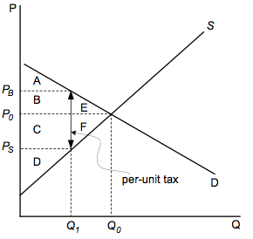
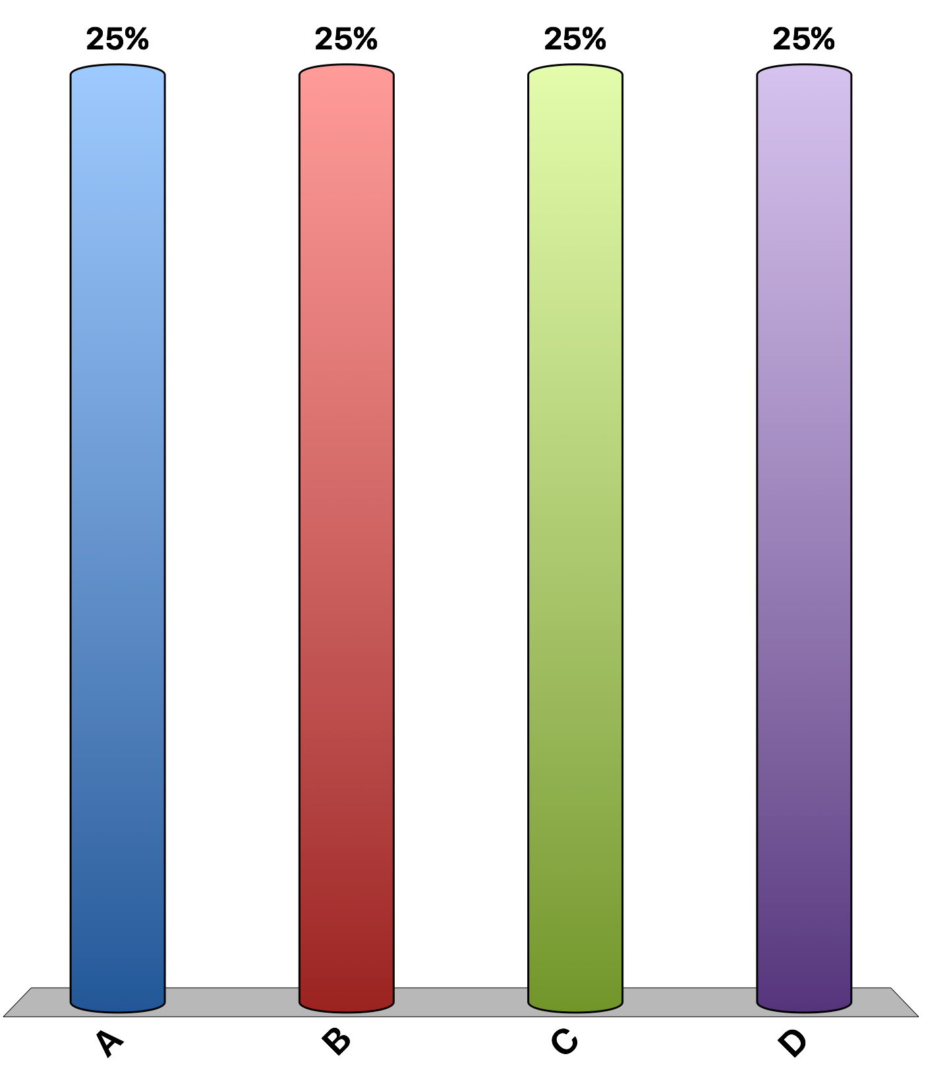
Refer to the figure. If there is no tax placed on the good in the market, total surplus is the area
A + B + C + D.
A + B + C + D + E + F.
B + C + E + F.
E + F.

Slide 6
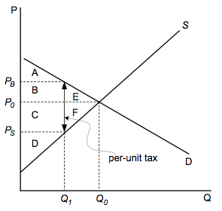
Refer to the figure. If the per-unit tax is placed on the good in the market, the tax revenue is the area
A + B + E
C + D + F
B + C
E + F

Slide 7
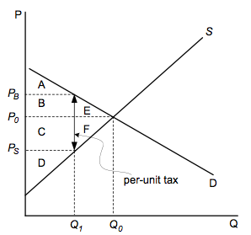
Refer to the figure. If the per-unit tax is placed on the good in the market, the consumer surplus is the area _____ and the producer surplus is the area ____, respectively.
A; D.
A + B + C; D + E + F.
D; C.
E; F.

Slide 8
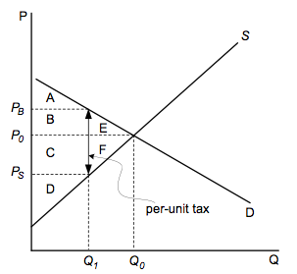
Refer to the figure. If the per-unit tax is placed on the good in the market, the deadweight loss is the area
B + C
B + C + E + F
A + B + C + D
E + F

Slide 9
The market of chocolate cupcakes is in equilibrium at a price of $4 and a quantity of 300 chocolate cupcakes. The government levies a $1 per unit tax, which decreases the quantity bought and sold to 250. Which of the following statements is incorrect?
the market experiences $25 in deadweight loss.
buyers have to pay more than $4 for one chocolate cupcake.
sellers receive less than $4 for one chocolate cupcake sold.
the tax revenue collected as a result of the new tax is $300.

Slide 10
The deadweight loss from a tax
reflects the fact that paying taxes reduces the purchasing power of income.
measures the revenue raised by the tax plus the administrative costs of the tax.
reflects the inefficiency in resource allocation because the tax distorts incentives.
measures the administrative costs of collecting taxes, such as the salaries of tax collectors.

Slide 11
The deadweight loss from a tax is likely to be smallest when
supply is elastic and demand is elastic.
supply is elastic and demand is inelastic.
supply is inelastic and demand is elastic.
supply is inelastic and demand is inelastic.

Slide 12
The market for gluten-free bread is characterized by an inelastic demand and an elastic supply. What would happen to the deadweight loss of a tax, if the supply would also be inelastic?
decrease.
increase.
not change.
we don’t have enough information to answer the question.

Slide 13
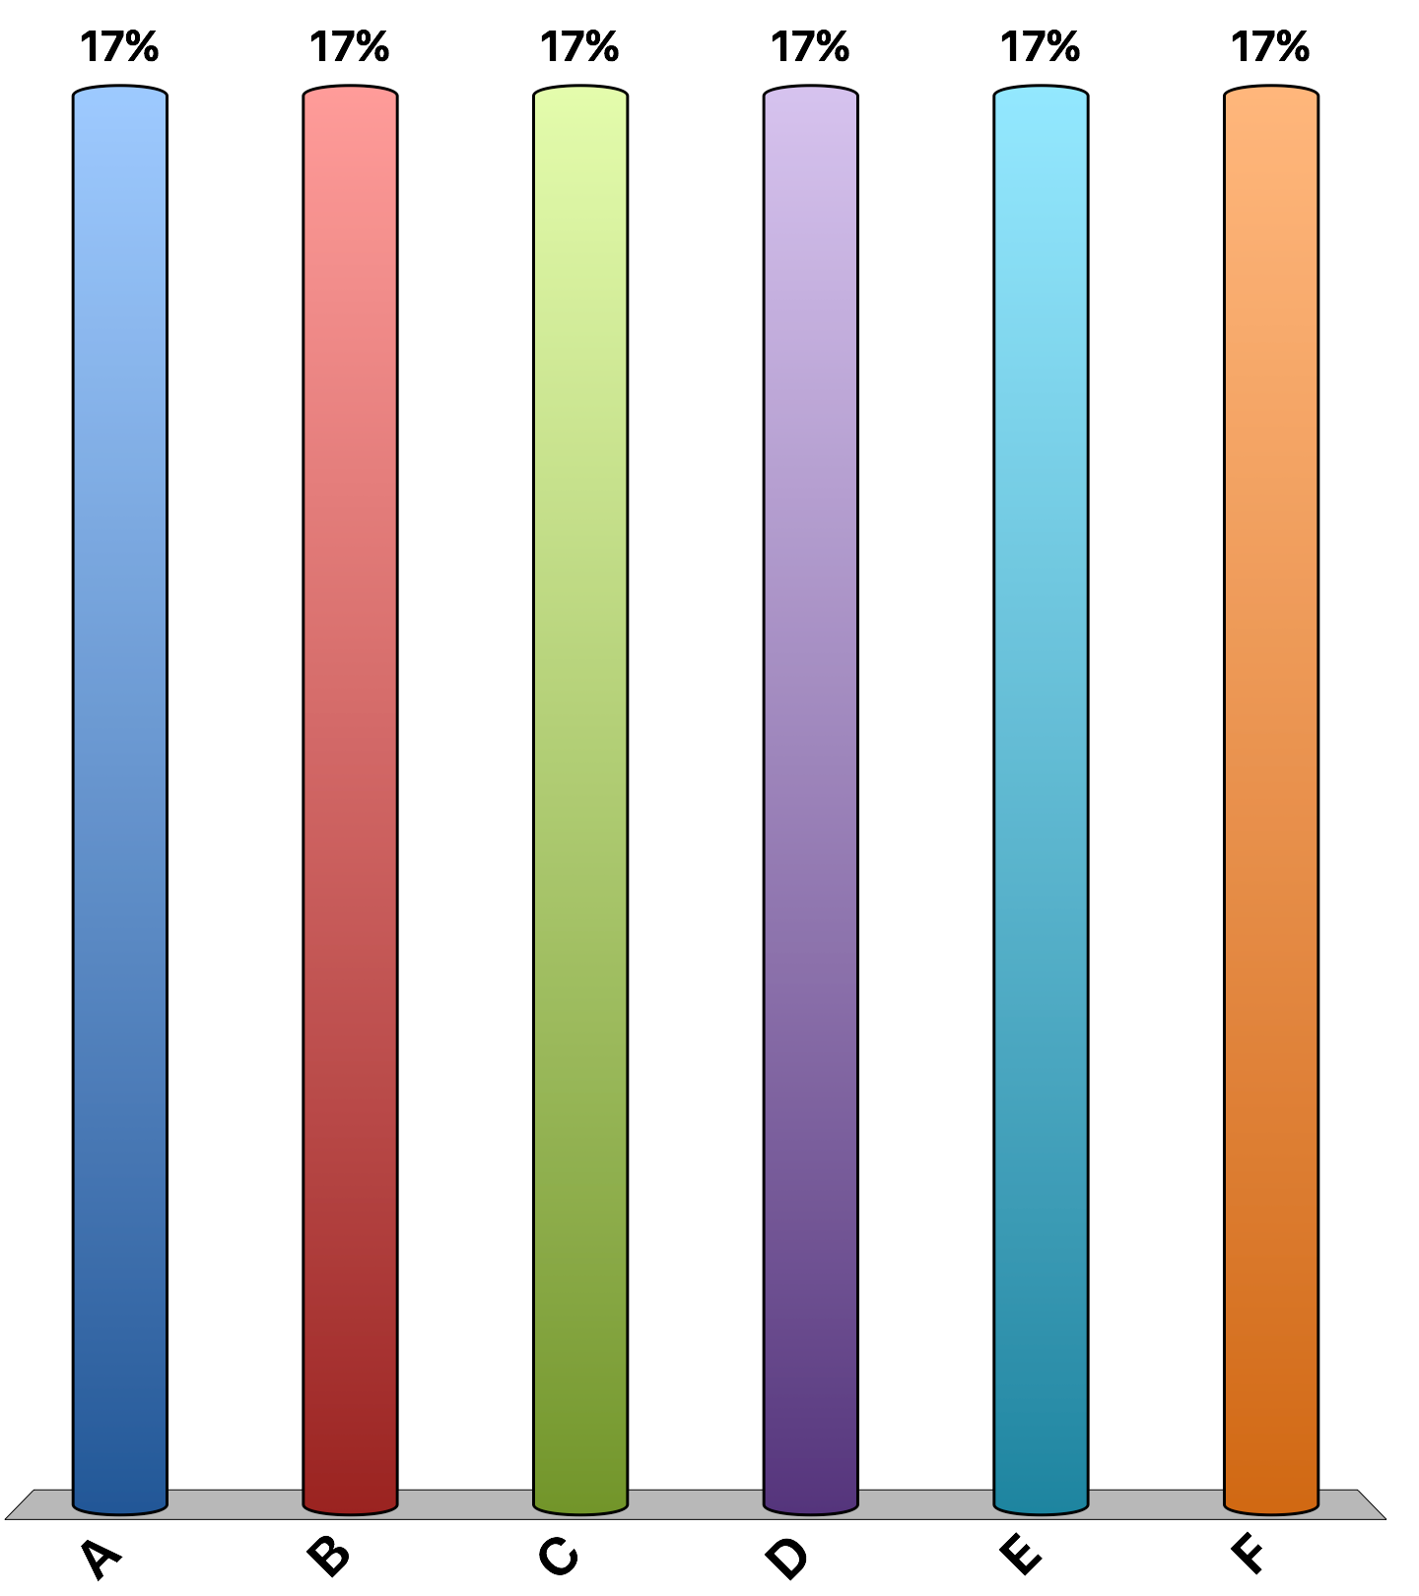
Imagine you have graduated and the salary for all graduates of this august institution is $60,000 per year. However, taxes reduce your take-home pay. At what level of taxation would you choose to stay home and not work?
10%
25%
35%
50%
75%
I would work regardless of tax level

Slide 14
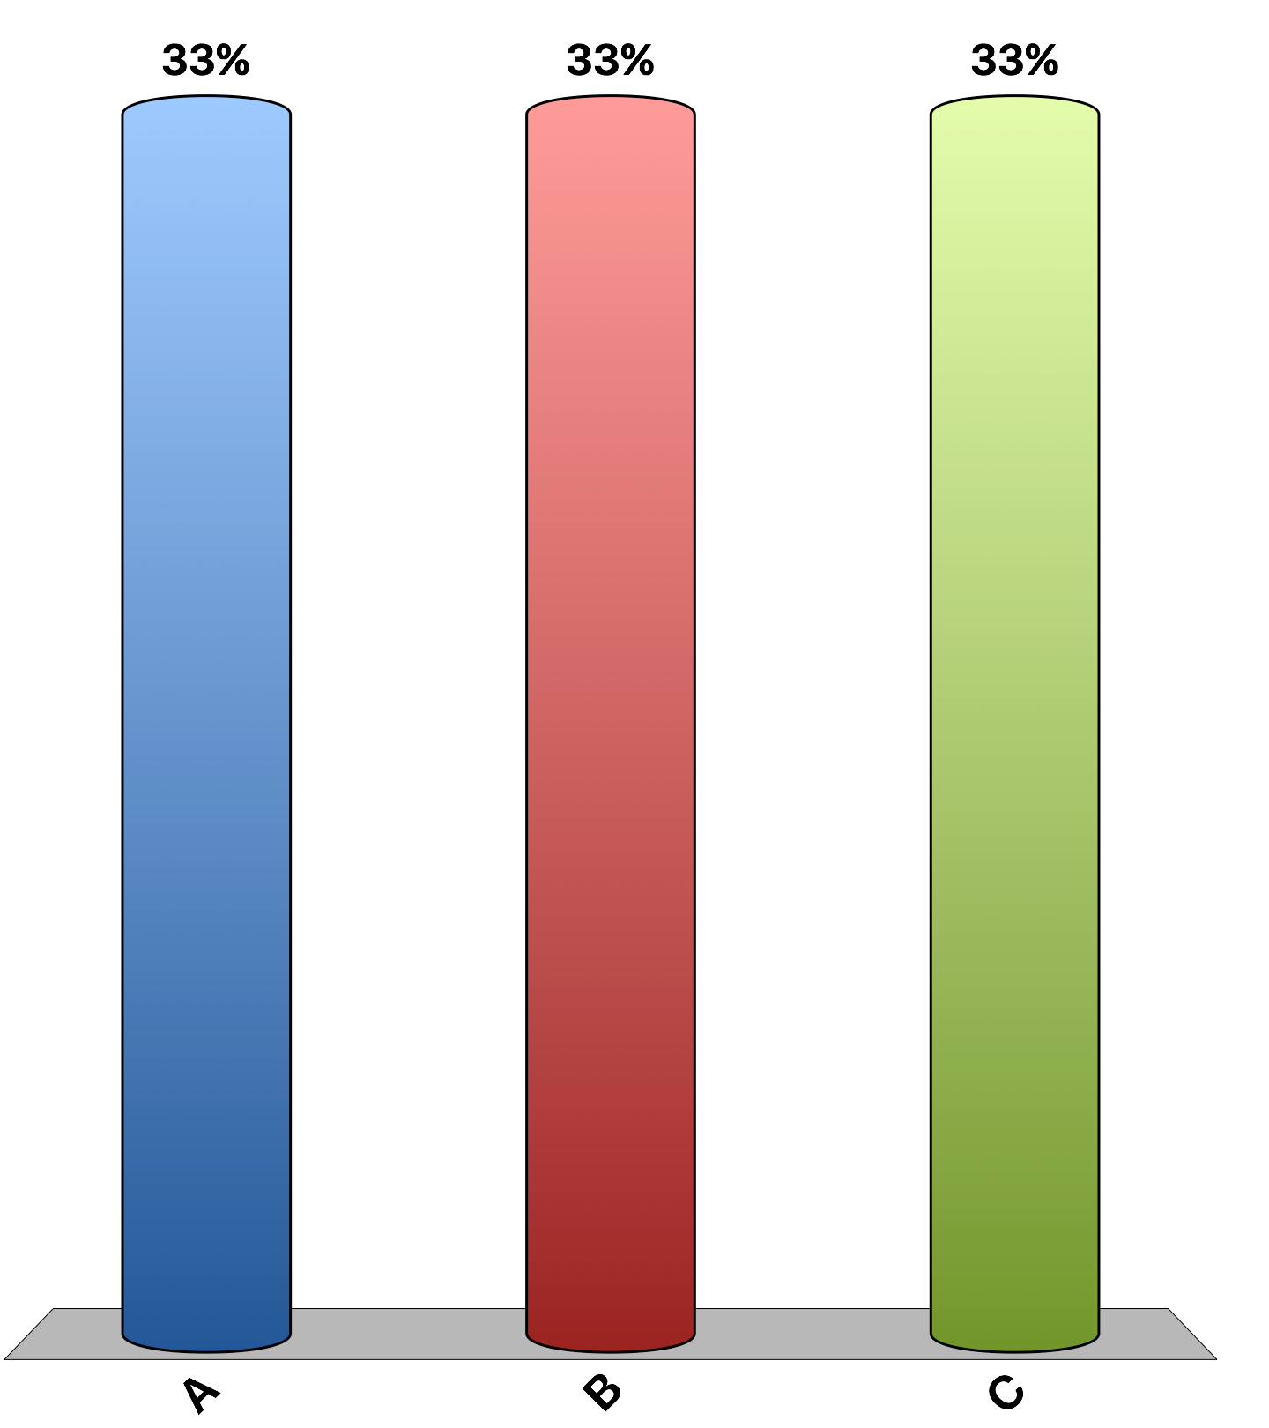
“A cut in federal income tax rates in the United States right now would lead to higher national income within five years than without the tax cut.”
agree
disagree
uncertain
Notes:
43% of economists agree, 9% disagree, and 4% are uncertain. This is the 'Ask the experts' feature in the textbook. Source: IGM Economic Experts Panel, June 26, 2012.

Slide 15
“A cut in federal income tax rates in the United States right now would raise taxable income enough so that the annual total tax revenue would be higher within five years than without the tax cut.”
agree
disagree
uncertain
Notes:
0% of economists agree, 96% disagree, and 4% are uncertain. This is the 'Ask the experts' feature in the textbook. Source: IGM Economic Experts Panel, June 26, 2012.

